Slide 1
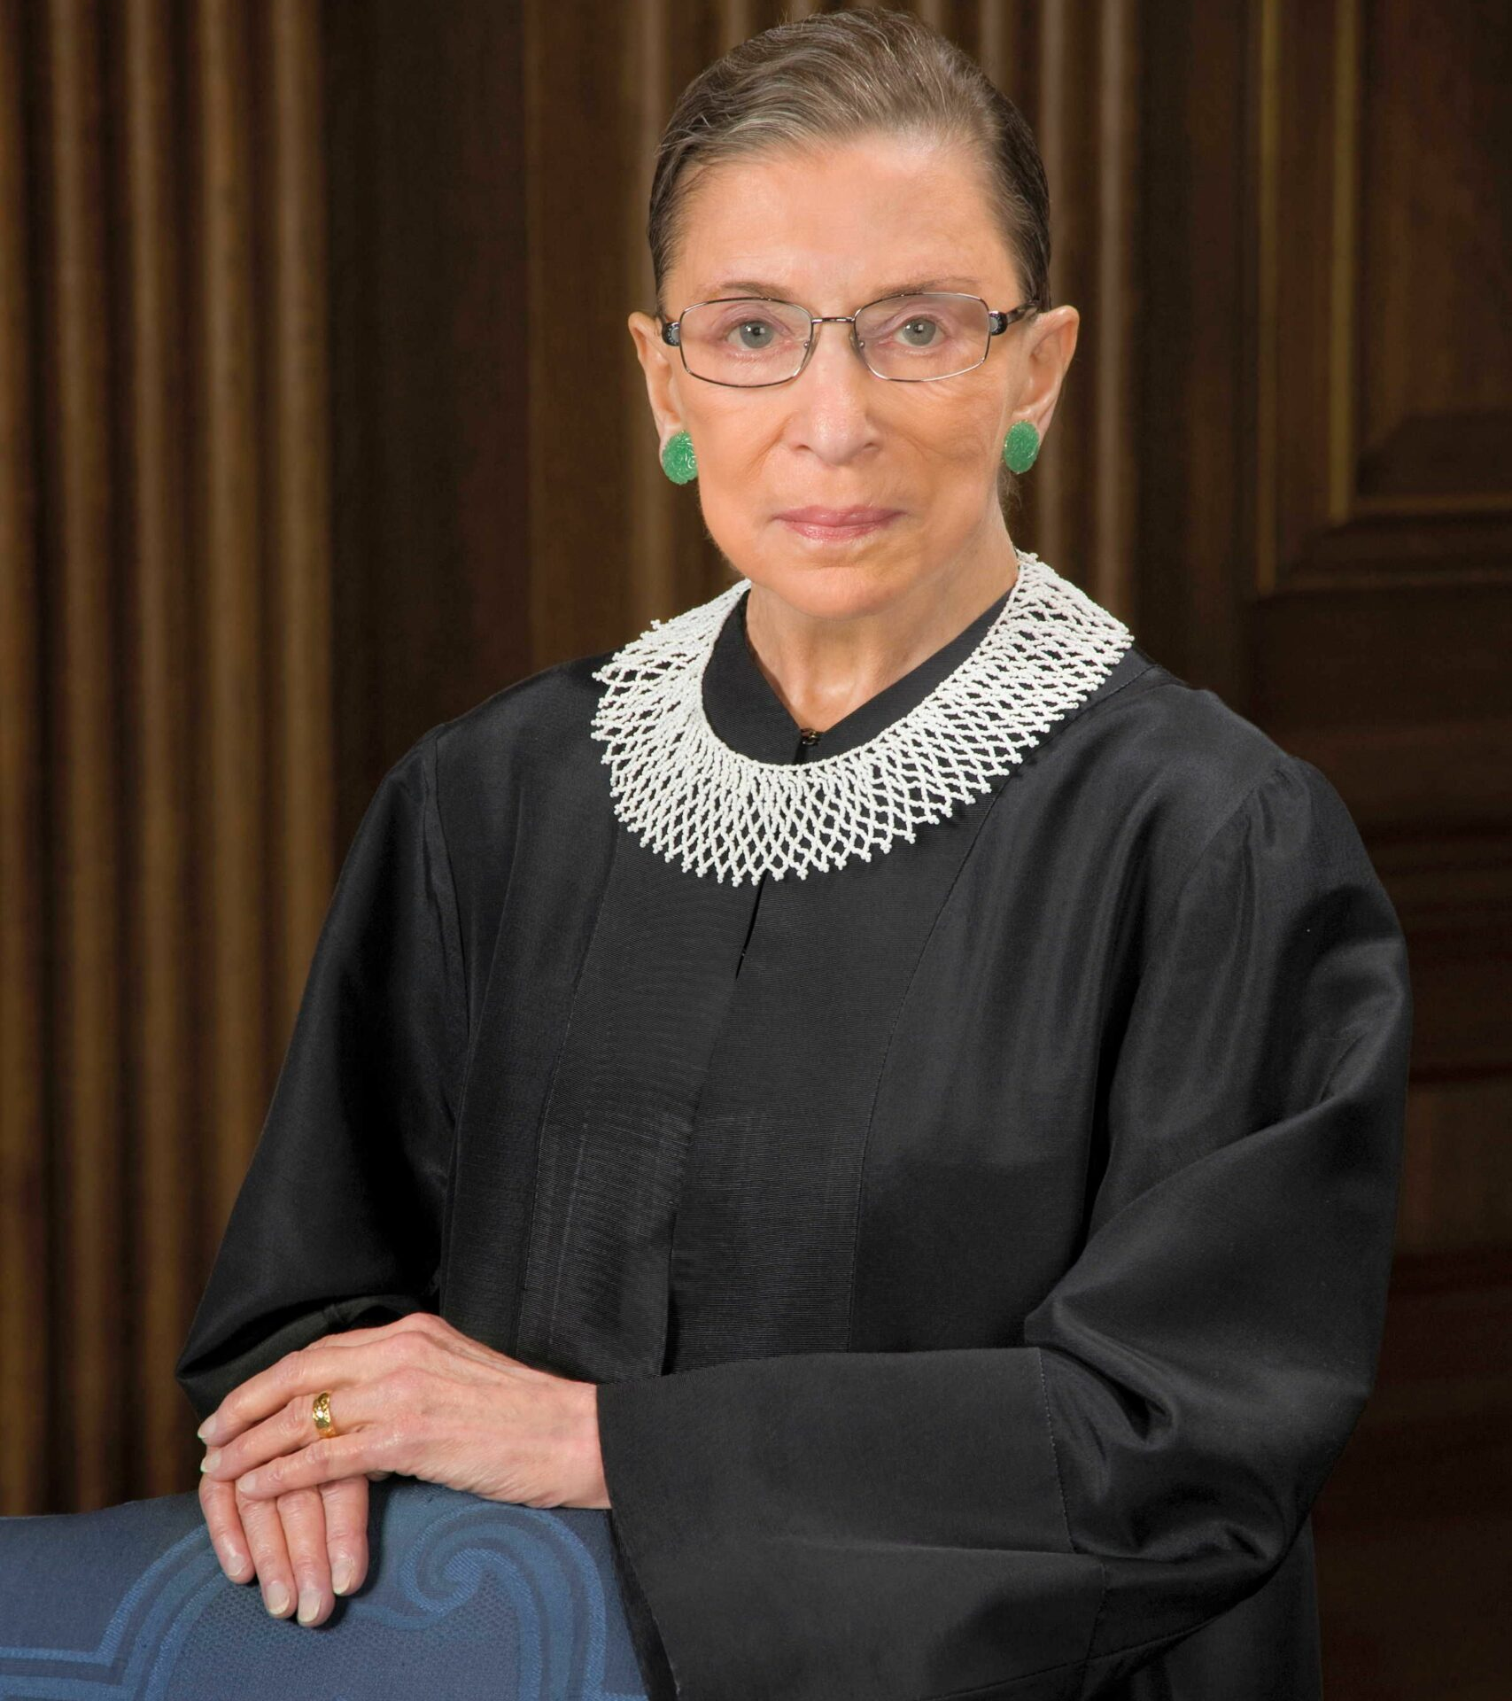
The Online RBG
Collection Exhibit
The Southwest Florida Library Presents
Featuring highlights from the Justice’s personal bookshelf.
Curator, developer, and designer:
Abigail Starcher
Official Supreme Court portrait.
Photo by Steve Petteway/ Collection of the Supreme Court of the United States.

Slide 2
Who was RBG?
Honorable Ruth Bader Ginsburg was a United States Supreme Court Justice who served on the Court from 1993 – 2020. She was born Joan Ruth Bader in Brooklyn, New York on March 15, 1933. She earned her B.A. from Cornell University, attended Harvard Law School, and received her LL.B. from Columbia Law School with highest honors. Despite her academic achievement, she faced significant discrimination in the legal field. She was belittled in law school by her colleagues and passed over for jobs due to her gender. Once in the workforce, she was not paid commensurate with her male colleagues with the same qualifications. She is famous for her work fighting for gender equality and women’s rights.
She is best known for her work with the following cases. First, she wrote the opinion for States v. Virginia, which held that qualified women could not be rejected from the Virginia Military Institute. She dissented in Ledbetter v. Goodyear Tire & Rubber Co., where the female plaintiff was being paid less than her male peers with the same qualifications. The plaintiff sued under Title VII but was denied relief under the statute of limitations. In her dissent to the case, Justice Ginsburg asked Congress to undo this improper interpretation of the law. Subsequently, this led Ginsburg to work with President Obama to pass the Lilly Ledbetter Fair Pay Act of 2009. She passed away on September 19, 2020 while still serving on the Court.

Slide 3
Timeline of RBG’s Life
1933 March 15: Born Joan Ruth Bader, Brooklyn, New York
1950 June 27: Graduates from James Madison High School, Brooklyn, New York (does not attend graduation due to mother’s death)
1954 June 14: Graduates from Cornell University
1954 June 23: Marries Martin D. (”Marty”) Ginsburg, a fellow student at Cornell, at his parents’ home in Long Island, New York
1954 Moves to Fort Sill, Oklahoma, for Marty’s Army service as an artillery school instructor and works in several clerical positions.
1955 Daughter Jane is born
1956 Enrolls in Harvard Law School, one year behind Marty, as one of the nine women students in a class of over 550
1957-1958 Marty battles cancer during his final years of law school
1958 Marty graduates from Harvard Law School and the family moves to New York

Slide 4
Timeline of RBG’s Life (Continued)
1958 Justice Ginsburg transfers to Columbia Law School
1959 Graduates from Columbia Law School tied for first in her class
1959 - 1961 Clerks for Hon. Edmund L. Palmieri, United States District Court for the Southern District of New York
1961 - 1963 Serves as research associate and then associate director of Columbia Law School Project on International Procedure.
1963 Joins the faculty at Rutgers School of Law, State University of New Jersey (one of two women on the faculty)
1965 Son James is born
1971 With Marty, represents Charles Moritz and co-authors first brief in a gender discrimination case Co-authors first Supreme Court brief in Reed v. Reed
1972 Joins the faculty of Columbia Law School with tenure
1972 Named director of the Americans Civil Liberties Union’s newly created Women’s Rights Project

Slide 5
Timeline of RBG’s Life (Continued)
1973 First Supreme Court oral argument, in Frontiero v. Richardson
1959 Graduates Columbia Law School tied for first in her class
1959 - 1961 Clerks for Hon. Edmund L. Palmieri, United States District Court for the Southern District of New York
1961 - 1963 Serves as research associate and then associate director of Columbia Law School Project on International Procedure.
1963 Joins the faculty at Rutgers School of Law, State University of New Jersey (one of two women on the faculty)
1974 With Kenneth M. Davidson and Herma Hill Kay, publishes Cases and Materials on Sex-Based Discrimination
1975 Argues Weinberger v. Wiesenfeld
1978 Argues her last case before the Supreme Court, Duren v. Missouri
1980 Appointed by President Carter to the United States Court of Appeals for the District of Columbia

Slide 6
Timeline of RBG’s Life (Continued)
1973 First Supreme Court oral argument, in Frontiero v. Richardson
1993 Appointed by President Clinton to the Supreme Court of the United States
1999 First bout with cancer (colorectal)
2007 Dissents in Ledbetter v. Goodyear Tire & Rubber Co.
2009 Second bout with cancer (pancreatic)
2013 Dissents in Shelby County v. Holder
2014 Dissents in Burwell v. Hobby Lobby Stores, Inc.
2018 Has surgery to address cancerous nodules on left lung discovered while being treated for rib fracture.
2019 Recurrence of pancreatic cancer
2020 September 18: Passes away from complications of metastatic pancreatic cancer

Slide 7
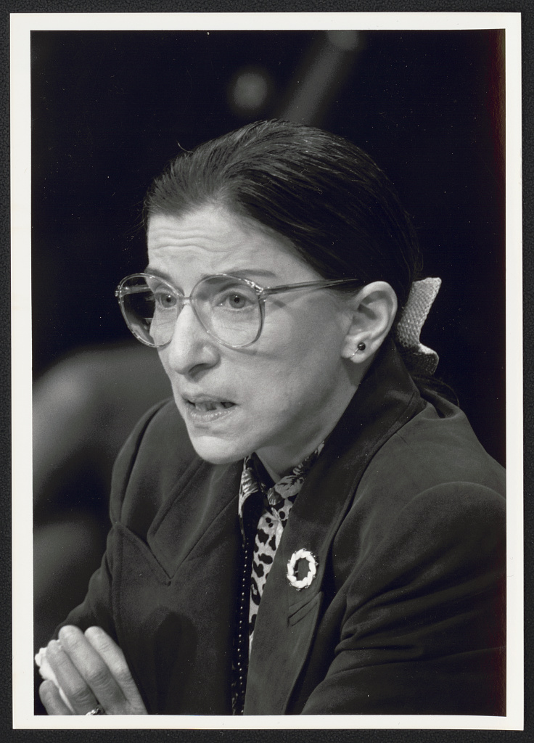
What is the RBG Collection?
The RBG collection contains her complete library at the time of her death in 2020. The collection is significant because it gives a window into the interests and life of Justice Ginsburg’s and what she held in her library till her death. Additionally, it highlights her relationships and the impact she had on people and they on her. It shows the human side of Justice Ginsberg and what interested her beyond the subject of law. Finally, it shows the mutual interests she shared with her husband, Martin, and the friendship they shared.
Ruth Bader Ginsburg testifies at her confirmation hearing before the Sen[ate] Judiciary Cmte. [Committee] / R. Michael Jenkins, Congressional Quarterly.

Slide 8
Objective of this Exhibit
The goal of this exhibit is for everyone to learn about the life and interests of the Supreme Court Justice Ruth Bader Ginsburg. Her personal bookshelf gives a rare view into the themes that were apart of her life. It highlights the people she encountered, the literature, art, music, legal texts, and political works that influenced her life. Furthermore, this exhibit is significant for historians studying Justice Ginsburg’s life and those who have an affinity with her. Finally, this exhibit celebrates who Justice Ginsburg was and her impact on the United States.

Slide 9
What was on RBG’s Bookshelf? - Law
Civil Rights (14 titles)
Constitutional Law (43 titles)
Death Penalty (4 titles)
Feminism (11 titles)
Free Speech & the Right to Privacy (8 titles)
Gender Discrimination (2 titles)
International Law (44 titles)
Jewish History and the Law (15 titles)
Judicial History (10 titles)
Judiciary and the Law (18 titles)
Law Reviews & Offprints Inscribed to Ruth Bader Ginsburg (20 titles)
Legal Humor (2 titles)
Legal Offprints (10 titles)
Legal Studies (14 titles)
Legal Writing, Grammar and Style (19 titles)
Lincoln Collection (11 titles)
Race and Justice (10 titles)
Religion and the Law (7 titles)
Swedish Law and Language (17 titles)

Slide 10

What was on RBG’s Bookshelf? – Law (Cont.)
Swedish Law and Language (17 titles)
The First Amendment (21 titles)
The Law in Modern Society (8 titles)
Women & Gender Studies (15 titles)
Women & the Law (19 titles)
Women in Society & Politics (21 titles)
Women’s Rights (13 titles)
Works on Global Issues Inscribed to RBG (10 titles)
A small selection from the 30 titles in RBG’s
Women and the Law book collection

Slide 11
What was on RBG’s Bookshelf? – Miscellaneous
Art & Philosophy (16 titles)
Art & Travel (25 titles)
Celebrity Biography & Memoirs Inscribed to RBG (11 titles)
Cooking (8 titles)
Churchills (6 titles)
Drama and Literature (5 titles)
Etiquette (3 titles)
First Ladies (7 Books)
Founding Fathers – America (20 titles)
Hawaii (8 titles)
History – 20th Century (6 titles)
History – American (7 titles)
History & Government (17 titles)
Gastronomy (9 titles)
Greek Mythology and Classical Studies (7 titles)
Grief and Widowhood (10 titles)
Investigative Journalism (11 titles)
Legal Writing, Grammar and Style (19 titles)
Literature (30 titles)
Literature: Mystery & Memoir (21 titles)

Slide 12

What was on RBG’s Bookshelf? – Miscellaneous (Cont.)
Modern Non-Fiction (17 titles)
Music & Musical Instruments (14 titles)
Opera & Lyrical Music (28 titles)
Philosophy (15 titles)
Politics – American (27 titles)
Reference Book on Writing (8 titles)
Shakespeare (9 titles)
Travel & Natural History (26 titles)
Universities (7 titles)
Wall Street & Wealth Inequality (9 titles)
RBG’s Universities titles

Slide 13
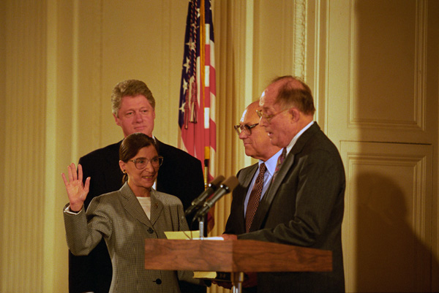
The Ruth Bader & Martin Ginsburg Bookshelf
Civil Rights (18 titles)
First Ladies (7 titles)
History, Biography, & Literature (10 titles)
History & Literature (26 titles)
Literature (120 titles)
Memoirs (6 titles)
Opera Including Maria Callas (16 titles)
Political & Legal History (10 titles)
Presidential Biographies (8 titles)
Physics and Mathematics (9 titles)
Supreme Court History (36 titles)
Women & the Law (11 titles)
President William J. Clinton attending the swearing-in ceremony of Judge Ruth Bader Ginsburg as Associate Supreme Court Justice on the State Floor of the White House. The image was photographed by Ralph Alswang.

Slide 14
Highlights from the RBG Collection

Slide 15
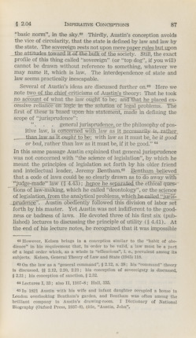
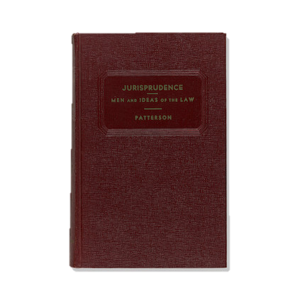
RBG’s Annotated Textbooks
Title: Jurisprudence: Men and Ideas of the Law
Author: Patterson, Edwin W.
Publisher: The Foundation Press
Year: 1953
This work is one of three textbooks in the collection from RBG’s time in Law School. This work, from her time at Columbia Law School, contains annotations. These annotations give an insight into what Ginsburg found important for her class and future career. It also demonstrates that she was a serioius student. Her meticulous work ultimately led her to graduating first in her class from Columbia Law School in 1959.

Slide 16
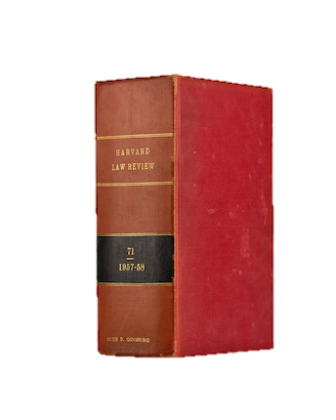
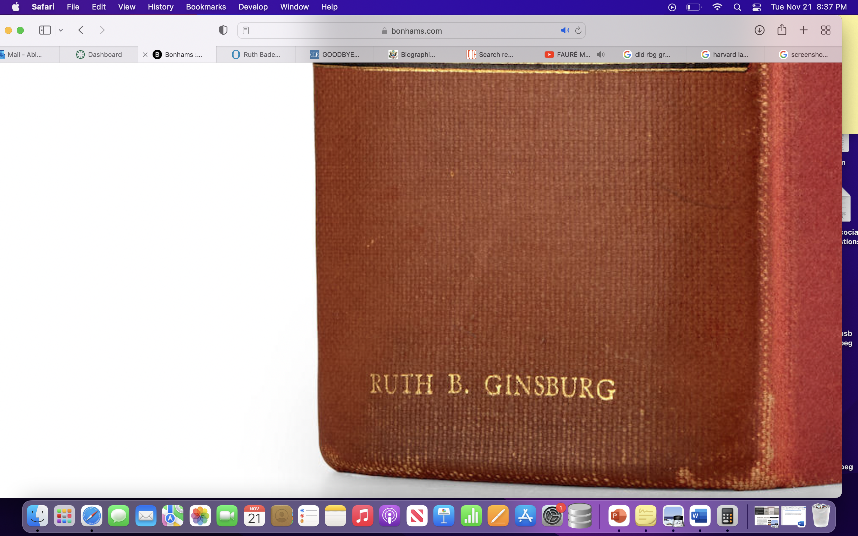
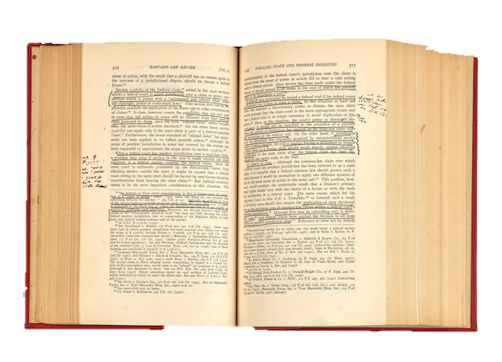
RBG’s Harvard Law Review Copy
Title: Harvard Law Review, Vol. 71
Publisher: The Harvard Law Review Association
Author: The Harvard Law Review Association
Year: 1957, 1958
Ginsburg joined the Harvard Law Review in her second year at law school. She was one of two women on the Review staff. The year she was on the Review, her husband was sick with cancer. This volume contains annotations and contributions by Ruth Bader Ginsburg. This particular copy has her name on the spine, as it was her personal copy

Slide 17
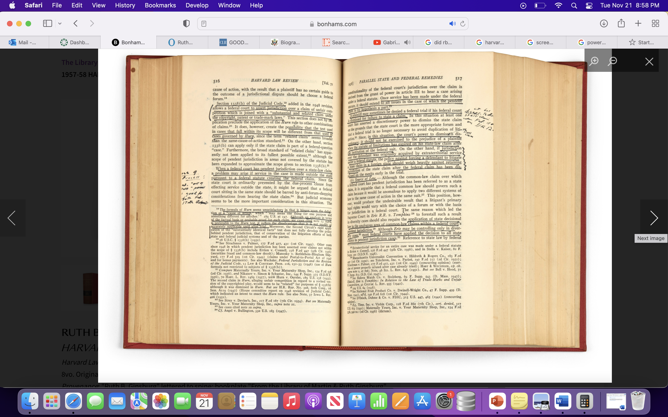
RBG’s Harvard Law Review Copy
(Enlarged version of text)

Slide 18
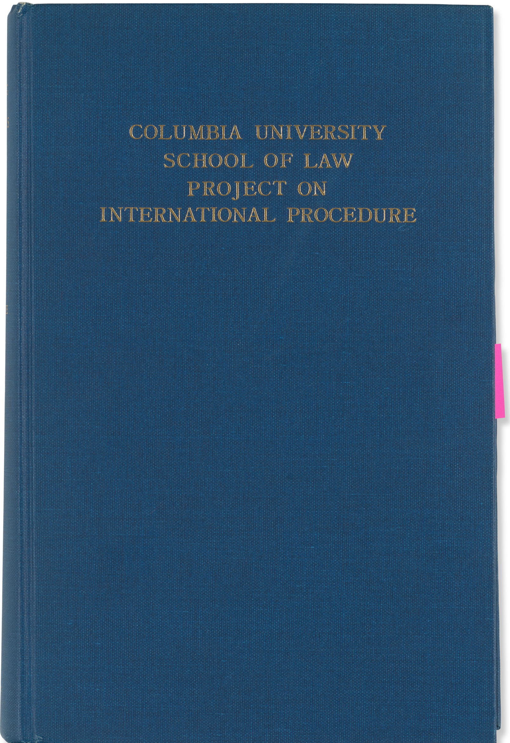

RBG’s Copy of Her First Published Book
Title: Civil Procedure in Sweden
Publisher: The Hague: Martinus Nijhoff Author: Bader Ginsburg, Ruth and Bruzelius, Anders
Year: 1965
Ginsburg’s copy of her first published book. This work is the first in the Columbia University Project on International Law. As Supreme Court Justice, she integrated her knowledge of international law in her judicial philosophy. For example, she was keenly aware of Sweden’s egalitarian society where two-income families were the norm. She advocated for this kind of society in the United States as a Justice.

Slide 19

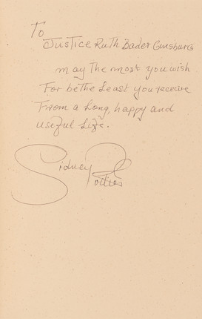
Sidney Poitier’s The Measure of a Man: A Spiritual Autobiography
Title: The Measure of a Man: A Spiritual Autobiography
Publisher: Harper Collins
Author: Poitier, Sydney
Year: 2000
Poitier was passionate about equal rights for all. He was active in film and theater in the late 1950s. His most famous films are In the Heat of Night and Raisin in the Sun. He was the first Black actor to receive an American Academy Award for Best Actor for Lilies of the Field (1963).
The inscription reads, “To Justice Ruth Bader Ginsburg, may the most you wish be the least you receive from a long, happy, and useful life. Sidney Poitier.”

Slide 20

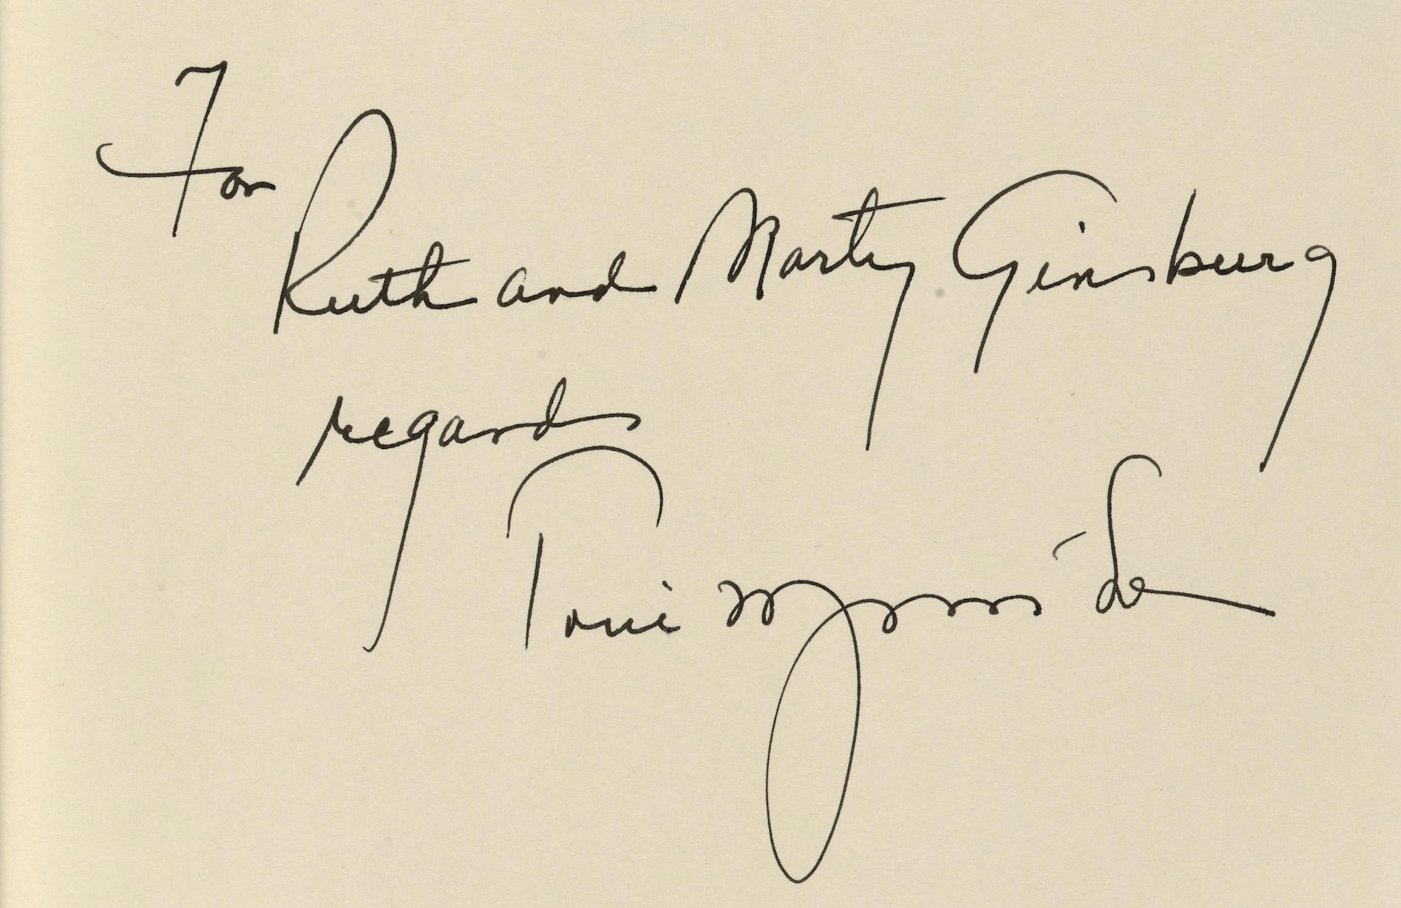
Tony Morrison’s Beloved: A Novel
Title: Beloved: A Novel
Publisher: Alfred A. Knopf
Author: Morrison, Toni
Year: 2005
Depicted is Ginsburg’s signed copy of Beloved by Morrison. Morrison went to Cornell University at the same time as Ginsburg and graduated a year later. The book is about a mother who attempted to kill her children rather than see them descend back into slavery. The inscription reads, “For Ruth and Marty Ginsburg, Regards, Toni Morrison.”

Slide 21

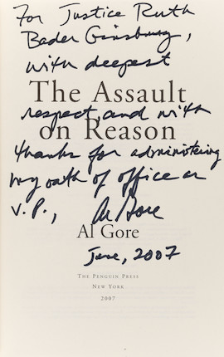
Al Gore’s The Assault on Reason
Title: The Assault on Reason
Publisher: The Penguin Press
Author: Gore, Al
Year: 2007
Shown here is Ginsburg’s signed copy of The Assault on Reason by Gore. This book is a critique of the George W. Bush era. Ginsburg swore Gore in for his second term as Vice President. The Justice also issued a dissent in the Bush v. Gore decision, which decided the 2000 election. The inscription reads, “For Justice Ruth Bader Ginsburg, with deepest regards and with thanks for administering my oath of office as V.P., Al Gore June, 2007.”

Slide 22

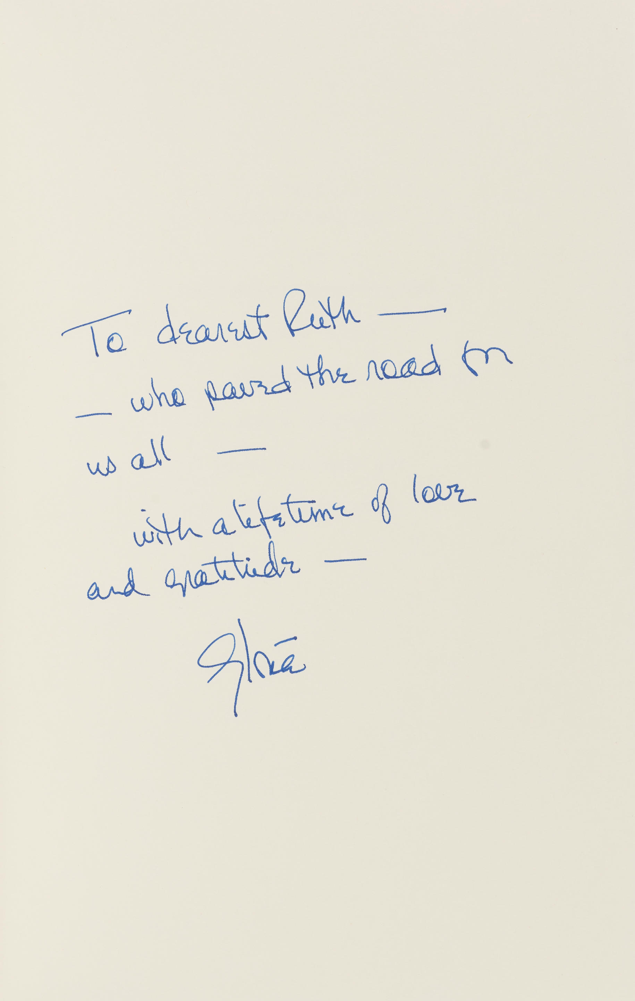
Gloria Steinem’s My Life on the Road
Title: My Life on the Road
Publisher: Random House
Author: Steinem, Gloria
Year: 2015
Ginsburg’s signed copy of My Life on the Road by Steinem. This book is about Steinem’s life on the road as one of strongest voices for women’s equality in the 1970s. The inscription reads, “To dearest Ruth – who paved the road for us all – with a lifetime of gratitude – Gloria.” Steinem was referring to Justice Ginsburg’s advocacy for women’s equality.

Slide 23

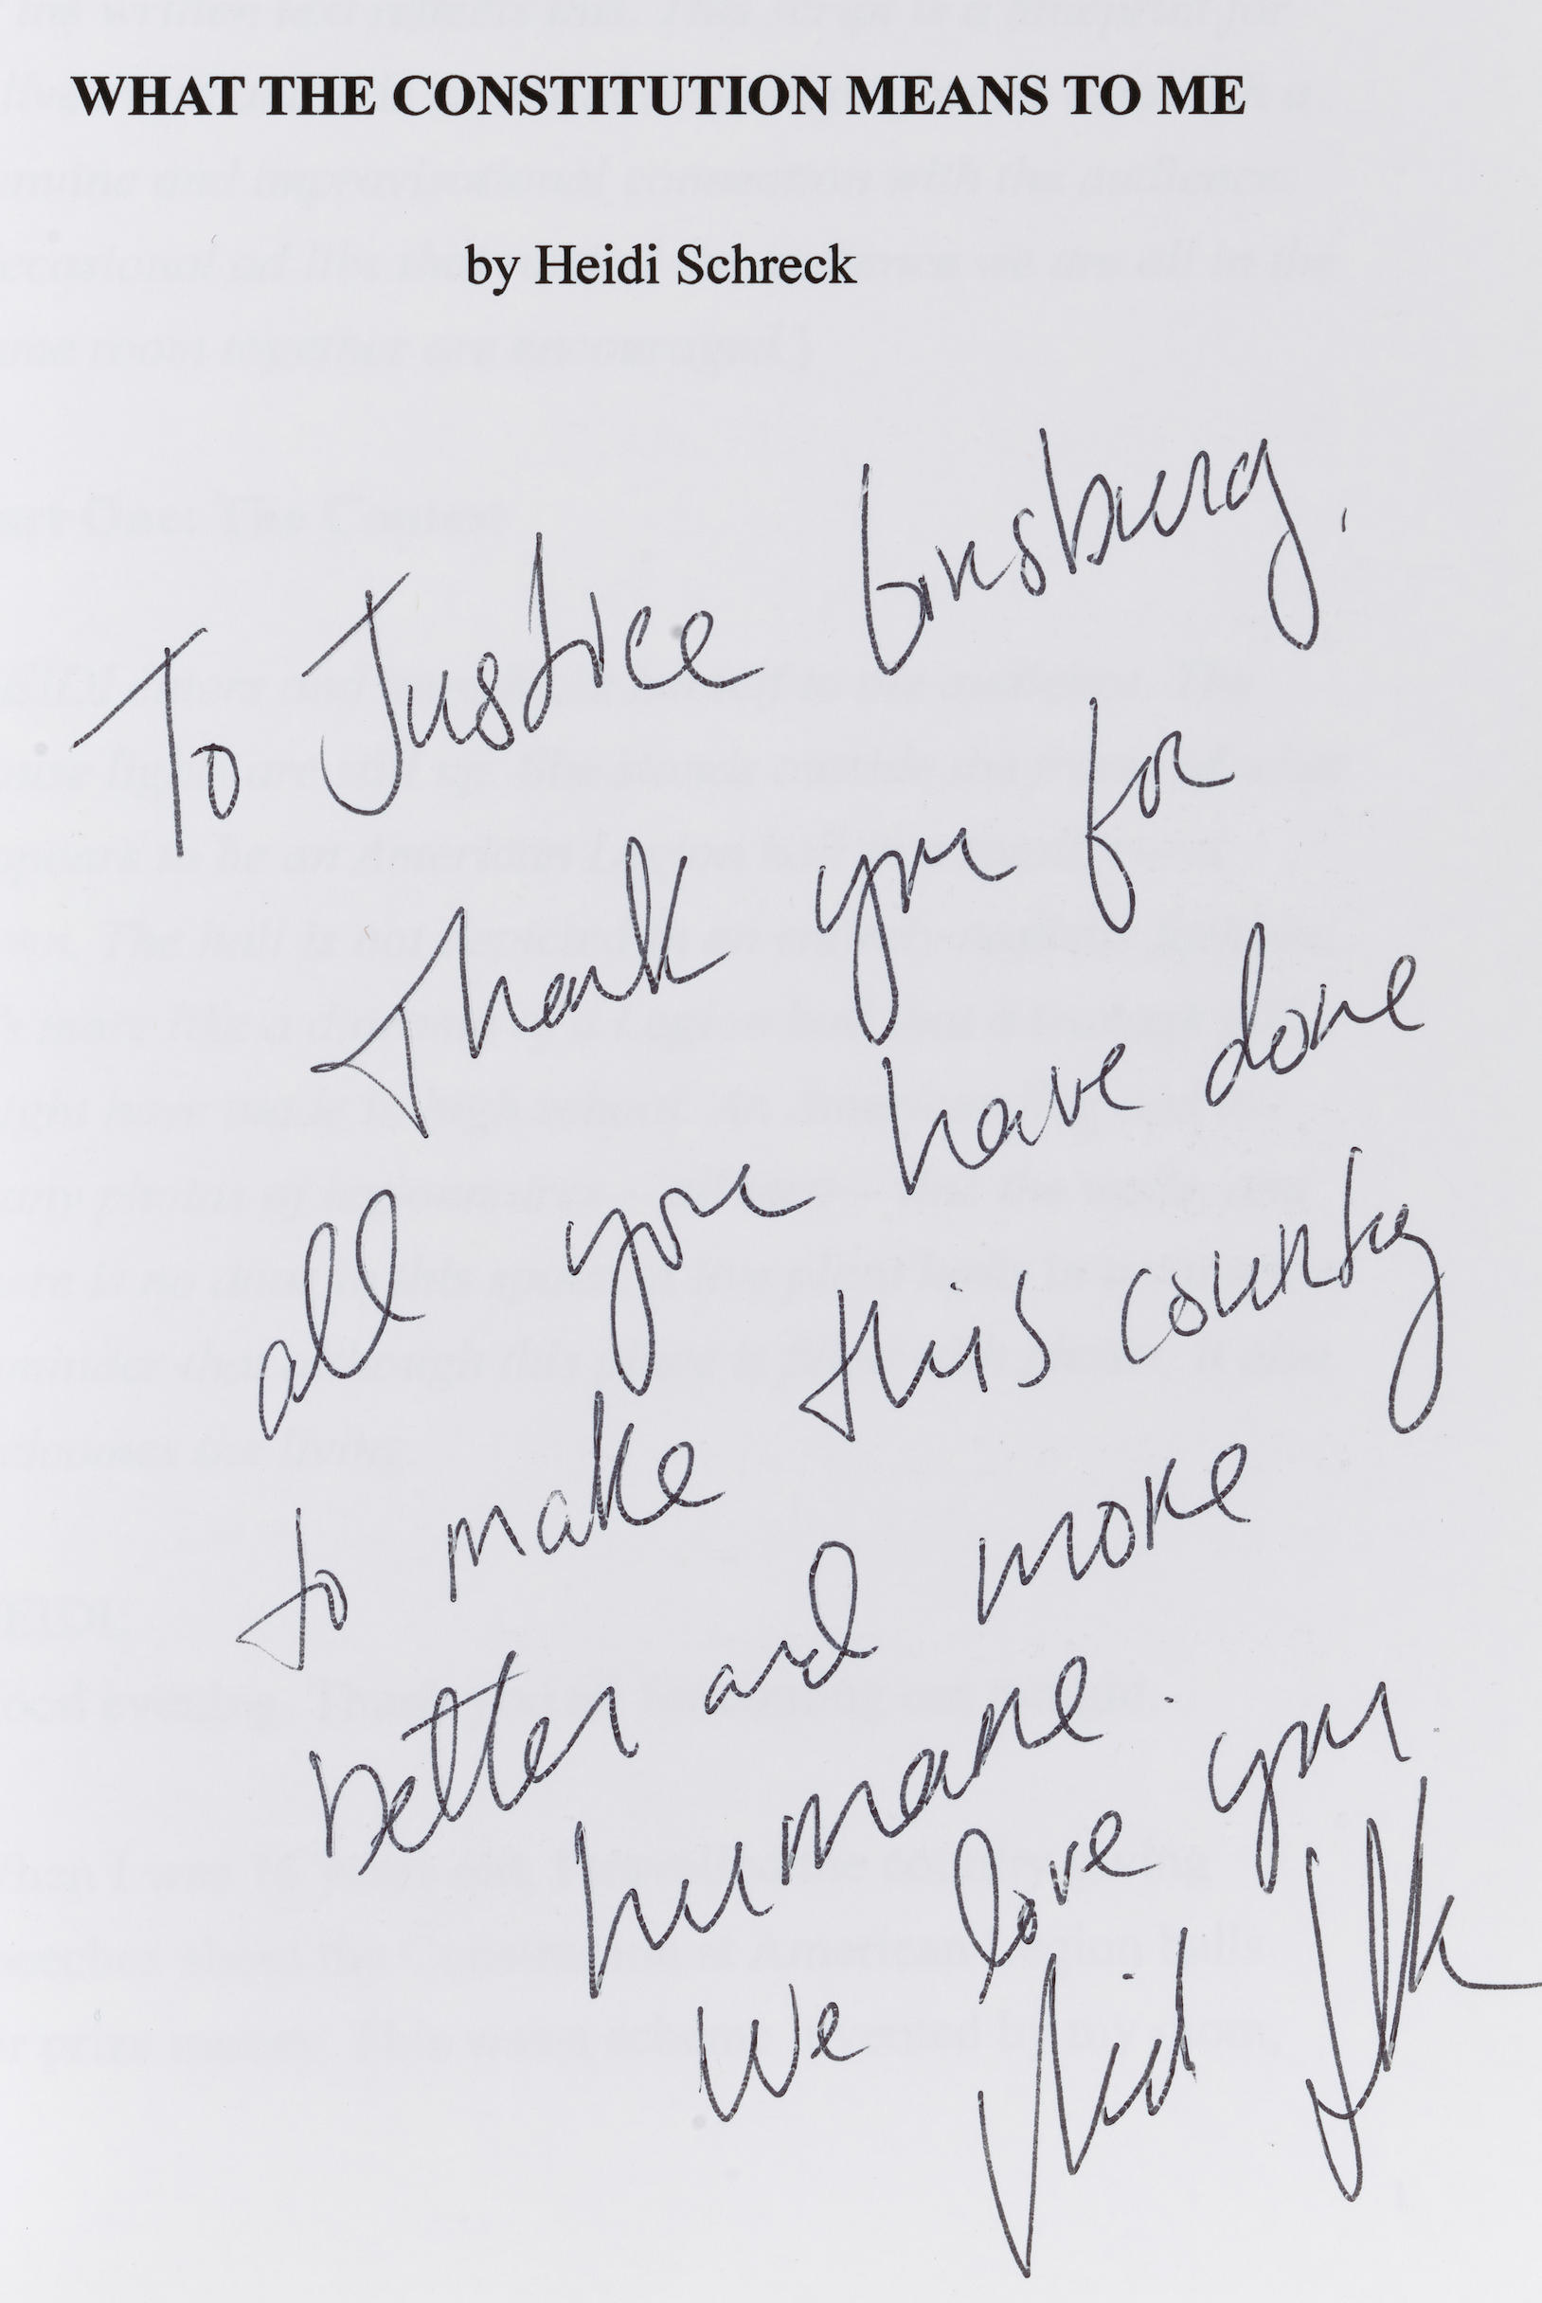
Heidi Schreck’s What the Constitution Means to Me
Title: What the Constitution Means to Me
Publisher: Self-Published
Author: Schreck, Heidi
Year: 2019
Schreck’s play ends with a voice recording of RBG being asked, “When will there be enough women on the court? and the Justice replied, “When there are 9.” Schreck sent a copy of the play to RBG. The inscription Schreck wrote to Ginsburg reads, “To Justice Ginsburg, Thank you for all you have done to make this country better and more humane, We love you, Heidi Schreck.” Ginsburg sent back a copy to Schreck of the play back with notes.

Slide 24
As demonstrated by this display,
Justice Ginsburg’s work had a tremendous impact on many lives. Featured were works that demonstrated her impact on women and those groups not given a voice by society. Finally, this exhibit was a celebration of her legacy and her impact on U.S. legislative history as one of the first female Justices on the court.

Slide 25
Thank you for viewing our virtual exhibit. More items from this collection can be viewed in person by booking an appointment with the library archivist at archivist@sfl.com. Additionally, select works can be viewed periodically in our display cases on the library’s first floor.

Slide 26
References
Bonhams. (2022, January). Al Gore presentation copy to Ruth Bader Ginsburg. https://www.bonhams.com/auction/27540/lot/40/al-gore-presentation-copy-to-ruth-bader-ginsburg-gore-al-the-assault-on-reason-new-york-the-penguin-press-2007/
Bonhams. (2022, January). Gloria Steinem’s memoir inscribed to Ruth Bader Ginsburg. https://www.bonhams.com/auction/27540/lot/62/gloria-steinems-memoir-inscribed-to-ruth-bader-ginsburg-steinem-gloria-my-life-on-the-road-new-york-random-house-2015/
Bonhams. (2022, January). Morrison presentation copy to Ruth Bader Ginsburg. https://www.bonhams.com/auction/27540/lot/38/morrison-presentation-copy-to-ruth-bader-ginsburg-morrison-toni-beloved-new-york-alfred-a-knopf-2005/
Bonhams. (2022, January). Ruth Bader Ginsburg’s annotated copy of the 1957 – 58 Harvard Law Review. https://www.bonhams.com/auction/27540/lot/3/ruth-bader-ginsburgs-annotated-copy-of-the-1957-58-harvard-law-review-harvard-law-review-volume-71-cambridge-ma-the-harvard-law-review-association-1957-1958/

Slide 27
References
Bonhams. (2022, January). Ruth Bader Ginsburg’s copy of her first published book. https://www.bonhams.com/auction/27540/lot/5/ruth-bader-ginsburgs-copy-of-her-first-published-book-ginsburg-ruth-bader-and-anders-bruzelius-civil-procedure-in-sweden-the-hague-martinus-nijhoff-1965/
Bonhams. (2022, January). Ruth Bader Ginsburg’s textbook for Columbia Law School class on jurisprudence. Patterson, Edwin W. https://www.bonhams.com/auction/27540/lot/4/ruth-bader-ginsburgs-textbook-for-columbia-law-school-class-on-jurisprudence-patterson-edwin-w-jurisprudence-men-and-ideas-of-the-law-brooklyn-the-foundation-press-1953/
Bonhams. (2022, January). Schreck’s award winning play inscribed to Ruth Bader Ginsburg. https://www.bonhams.com/auction/27540/lot/74/schrecks-award-winning-play-inscribed-to-ruth-bader-ginsburg-schreck-heidi-what-the-constitution-means-to-me-self-published-2019/
Bonhams. (2022, January). Sidney Poitier inscribes his memoir to Justice Ginsburg. Poitier, Sidney. https://www.bonhams.com/auction/27540/lot/29/sidney-poitier-inscribes-his-memoir-to-justice-ginsburg-poitier-sydney-the-measure-of-a-man-new-york-harper-collins-2000/

Slide 28
References
Oyez. (n.d.). Ruth Bader Ginsburg. https://www.oyez.org/justices/ruth_bader_ginsburg
Supreme Court of the United States. (n.d.). Biography of Associate Justice Ruth Bader Ginsburg. The Supreme Court of the United States. https://www.supremecourt.gov/about/biographyginsburg.aspx
University of California Press. (2022, March 15). Remembering the life of Ruth Bader Ginsburg. UC Press Blog. https://www.ucpress.edu/blog/57263/remembering-the-life-of-ruth-bader-ginsburg/

Slide 29
References
Photos Credits
Alswang, R. (1993). Chief Justice William Rehnquist administers the oath of office to Judge Ruth Bader Ginsburg as Associate Supreme Court Justice at the White House. [Photograph] National Archives and Records Administration. https://catalog.archives.gov/id/3144719
Jenkins, R. M. (1993). Ruth Bader Ginsburg testifies at her confirmation hearing before the Senate Judiciary Cmte. Committee / R. Michael Jenkins, Congressional Quarterly. [Photograph]. Library of Congress. https://www.loc.gov/item/2019630721/ .
Petteway, S. (2010). Official Supreme Court portrait. [Photograph]. Supreme Court of the United States. https://blogs.loc.gov/copyright/2021/02/the-enduring-copyright-legacy-of-justice-ruth-bader-ginsburg/

